Slide 1
Brain Computer Interaction
Feature Extraction
Course Instructors
Dr. Sreeja S R
Assistant Professor
Indian Institute of Information Technology
IIIT Sri City

Slide 2
Features
The purpose of a BCI is to detect and quantify characteristics of brain signals that indicate what the user wants the BCI to do, to translate these measurements in real time into the desired device commands, and to provide concurrent feedback to the user.
The brain-signal characteristics used for this purpose are called signal features, or simply features.
Feature extraction is the process of distinguishing the pertinent signal characteristics from extraneous content and representing them in a compact and/or meaningful form, amenable to interpretation by a human or computer.

Slide 3
Overall structure of a BCI

Slide 4
Feature vector
A fundamental signal feature is simply a direct measurement of the signal. They usually provide limited relevant information about typically complex brain signals.
Thus, it is more common for BCIs to use features that are linear or nonlinear combinations, ratios, statistical measures, or other transformations of multiple fundamental features detected at multiple electrodes and/or multiple time points.
Such complex features, if selected appropriately, can reflect the user’s desires more accurately than the fundamental features themselves.
Most features used in BCI applications are based on spatial, temporal, and/or spectral analyses of brain signals or the relationships among them.
Furthermore, in order to determine the user’s wishes as accurately as possible, most BCIs extract a number of features simultaneously. This set of features is referred to as a feature vector.

Slide 5
Feature vector
To be effective for BCI applications, a feature should have the following attributes:
its spatial, temporal, spectral characteristics, and dynamics can be precisely characterized for an individual user or population of users
it can be modulated by the user and used in combination with other features to reliably convey the user’s intent
its correlation with the user’s intent is stable over time and/or can be tracked in a consistent and reliable manner

Slide 6
SECOND STEP: EXTRACTING THE FEATURES
BLOCK PROCESSING
For most BCI applications, it is highly desirable for the processing to occur in real time. Prior to feature extraction, the incoming signal samples are commonly segmented into consecutive, possibly overlapping, sample blocks.
A feature vector is created from the signal samples within each individual sample block. The feature vectors from the successive sample blocks are then fed to the translation algorithm, which produces a device command or user feedback corresponding to each sample block or corresponding to sets of consecutive sample blocks.
For efficient online implementation, the length and overlap of these sample blocks should fit the relevant temporal dynamics of the signal, the feature-extraction method, the nature of the application, and the concurrent user feedback, as well as the available processing power.
E.g., BCI cursor control
P300 response

Slide 7
SECOND STEP: EXTRACTING THE FEATURES
TIME (TEMPORAL) FEATURES
Peak-Picking and Integration
Peak-picking simply determines the minimum or maximum value of the signal samples in a specific time block (usually defined relative to a specific preceding stimulus) and uses that value (and possibly its time of occurrence) as the feature(s) for that time block.
The signal can be averaged or integrated over all or part of the time block to yield the feature(s) for the block. Some form of averaging or integration is typically preferable to simple peak-picking, especially when the responses to the stimulus are known to vary in latency and/or when unrelated higher-frequency activity is superimposed on the relevant feature

Slide 8
SECOND STEP: EXTRACTING THE FEATURES
TIME (TEMPORAL) FEATURES
Correlation and Template-Matching
The similarity of a response to a predefined template might also be used as a feature.
Comparing signals in time-domain
X = [1, 2, 3, 2]
Y = [2, 3, 2, 0]
Find the cross-correlation

Slide 9
SECOND STEP: EXTRACTING THE FEATURES
Statistical features
Sl. No | Features | Short description
1 | MEAN | Mean value
2 | STD | Standard deviation
3 | MAX VALUE | Maximum positive amplitudes
4 | MIN VALUE | Maximum negative amplitudes
5 | SKEWNESS | a measure of asymmetry of the distribution
6 | KURTOSIS | a measure of flatness of the distribution
7 | MEDIAN | the middle value of a set of ordered data

Slide 10
SECOND STEP: EXTRACTING THE FEATURES
Interval or period analysis features.
Sl. No | Features | Short description
8 | LINE LENGTH | Line length
9 | MEAN VV AMPL | Mean of vertex-to-vertex amplitudes
10 | VAR VV AMPL | Variance of vertex-to-vertex amplitudes
11 | MEAN VV TIME | Mean of vertex-to-vertex times
12 | VAR VV TIME | Variance of vertex-to-vertex times
13 | MEAN VV SLOPE | Mean of vertex-to-vertex slope
14 | VAR VV SLOPE | Variance of vertex-to-vertex slope
15 | ZERO CROSSING | Number of zero crossings in a signal
16 | MIN MAX NUMBER | Number of local minima and maxima
17 | COEFF OF VARIATION | a statistical measure of the deviation of a variable from its mean, standard deviation divided by mean
18 | AMPL RANGE | The difference between the maximum positive and maximum negative Amplitude values

Slide 11
SECOND STEP: EXTRACTING THE FEATURES
Features derived from the first and second derivative.
Sl. No | Features | Short description
19 | 1st DIFF MEAN | Mean value of the first derivative of the signal
20 | 1st DIFF MAX | Maximum value of the first derivative of the signal
21 | 2nd DIFF MEAN | Mean value of the second derivative of the signal
22 | 2nd DIFF MAX | Maximum value of the second derivative of the signal

Slide 12
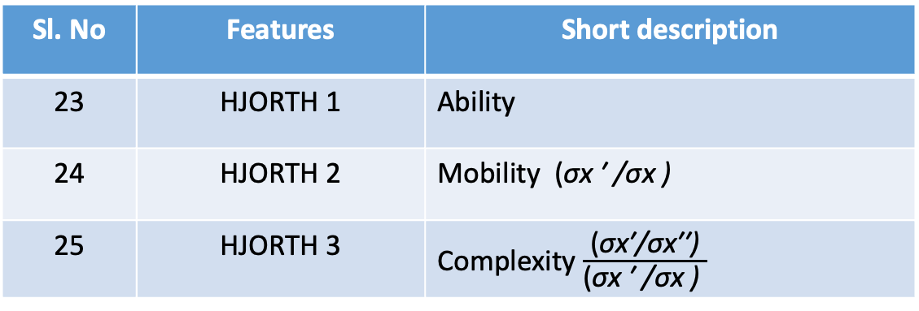
SECOND STEP: EXTRACTING THE FEATURES
The Hjorth parameters
Sl. No | Features | Short description
23 | HJORTH 1 | Ability
24 | HJORTH 2 | Mobility (σx ′ /σx )
25 | HJORTH 3 | Complexity $\frac{\text{(}\text{σ}\text{x}\text{′/}\text{σ}\text{x}\text{′′}\text{)}}{\text{(}\text{σ}\text{x}\text{ ′ /}\text{σ}\text{x}\text{ )} }$
NOTE:
σx ′ is the standard deviation of the first derivative of the signal
σx′′ is the standard deviation of the second derivative of the signal

Slide 13
SECOND STEP: EXTRACTING THE FEATURES
FREQUENCY (SPECTRAL) FEATURES
Much brain activity manifests itself as continuous amplitude- and frequency-modulated oscillations. Therefore, it is often advantageous to accurately track these changes in the frequency domain. Although the Fourier transform is the most common method for converting from the time domain to the frequency domain, there are several alternatives that have characteristics that are particularly desirable given specific constraints or specific objectives. These include:
band power
fast Fourier transform (FFT)
Magnitude squared coherence (MSC)
Power spectral densities

Slide 14
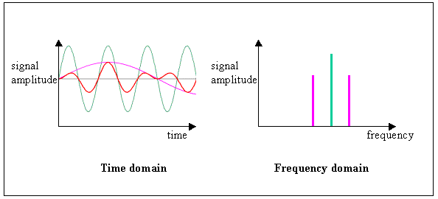

Slide 15
SECOND STEP: EXTRACTING THE FEATURES
FFT-based features calculated from the EEG spectra.
Sl. No | Features | Short description
26 | FFT DELTA | 0.1 - 3 Hz
27 | FFT THETA | 3 - 7 Hz
28 | FFT ALPHA | 7 - 12 Hz
29 | FFT BETA | 12 - 30 Hz
30 | FFT GAMMA | 30 - 40 Hz
31 | FFT WHOLE | 0.1 - 40 Hz

Slide 16
SECOND STEP: EXTRACTING THE FEATURES
FFT-based Spectral Features.
Sl. No | Features | Short description
32 | FFT DT RATIO | DELTA / THETA
33 | FFT DA RATIO | DELTA / ALPHA
34 | FFT TA RATIO | THETA / ALPHA
35 | FFT DTA RATIO | (DELTA + THETA) / ALPHA
36 | FFT SEF | Spectral edge frequency (95 % of the total spectral power resides)
37 | FFT SP-ROLL OFF | The frequency below which 85 % of the total spectral power resides
Spectral edge frequency 95 (SEF 95 : the frequency below which 95 % of the EEG power is located) was calculated. Spectral bands of 0–4 Hz (delta) 4–8 Hz (theta), 8–13 Hz (alpha) and 13–30 Hz (beta) were analysed and the power of the spectral bands were calculated and expressed as percentage of total power.

Slide 17
SECOND STEP: EXTRACTING THE FEATURES
Wavelet based Features.
Sl. No | Features | Short description
38 | MIN WAV VALUE | Minimum value
39 | MAX WAV VALUE | Maximum value
40 | MEAN WAV VALUE | Mean value
41 | MEDIAN WAV VALUE | Median value
42 | STD WAV VALUE | Standard deviation
43 | SKEWNESS WAV VALUE | Skewness
44 | KURTOSIS WAV VALUE | Kurtosis
45 | WAV BAND | Relative energy

Slide 18
SECOND STEP: EXTRACTING THE FEATURES
Wavelet based Features.
Sl. No | Features | Short description
46 | ENTROPY SPECTRAL WAV | The spectral entropy
47 | 1st DIFF WAV MEAN | Mean value of the 1st derivative
48 | 1st DIFF WAV MAX | Maximum value of the 1st derivative
49 | 2nd DIFF WAV MEAN | Mean value of the 2nd derivative
50 | 2nd DIFF WAV MAX | Maximum value of the 2nd derivative
51 | ENERGY PERCENT WAV | Percentage of the total energy of a detail/approximation
52 | WAV ZERO CROSSING | Zero crossing
53 | WAV COEFF OF VARIATION | Coefficient of variation
54 | WAV TOTAL ENERGY | Total Energy

Slide 19
SECOND STEP: EXTRACTING THE FEATURES
Other Features.
Sl. No | Features | Short description
55 | ENTROPY SPECTRAL | The spectral entropy
56 | ENTROPY SHANNON | The Shannon entropy
57 | MAX ABS XCORR EEG-EEG | Maximum positive amplitude of auto-correlation or cross-Correlation function
58 | MEAN ABS XCORR EEG-EEG | Mean value of auto-correlation or cross-correlation function

Slide 20
THIRD STEP: FEATURE CONDITIONING / Selection
The distributions and the relationships among the features can have a significant effect on the performance of the translation algorithm that follows feature extraction. These effects depend on the characteristics of the particular translation algorithm.
NORMALIZATION
LOG-NORMAL TRANSFORMS
FEATURE SMOOTHING

Slide 21
Feature selection
Feature selection methods helps to select or drop features depending on some performance measure.
Reducing the number of irrelevant features will drastically improve the learning performance, lower the computational complexity and decrease the required storage.
The most commonly used feature selection strategies are forward search methods and backward elimination methods. The former method starts with one feature initially and builds large feature set iteratively, whereas the latter starts with the large feature set and remove features iteratively.
Filter method, wrapper method and embedded method

Slide 22
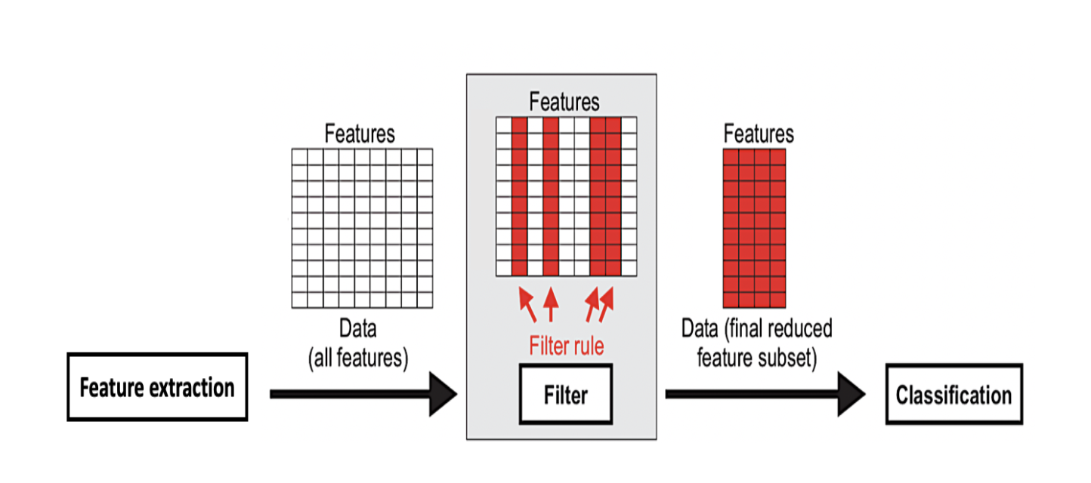
Feature selection – Filter Method
Filter methods chooses a feature subset from the large feature set applying some filter rules before training the classifier model.
The filter rule may be derived from prior knowledge or using some data statistics.
In order to work efficiently, filter methods need a strong assumptions about the class distribution.
If the rightful assumptions are given, they work very fast and return best possible solutions.
On the other hand, if the false assumptions are considered, filter methods perform very poor.

Slide 23
Feature selection – Filter Method
Filter methods rank the features one-by-one based on the relevance score.
Finally, the user need to define the number of features or a threshold of a score to determine the subset of features.
The methods that follows filter approach are correlation coefficient, mutual information, fisher criterion, Laplacian score, etc.

Slide 24
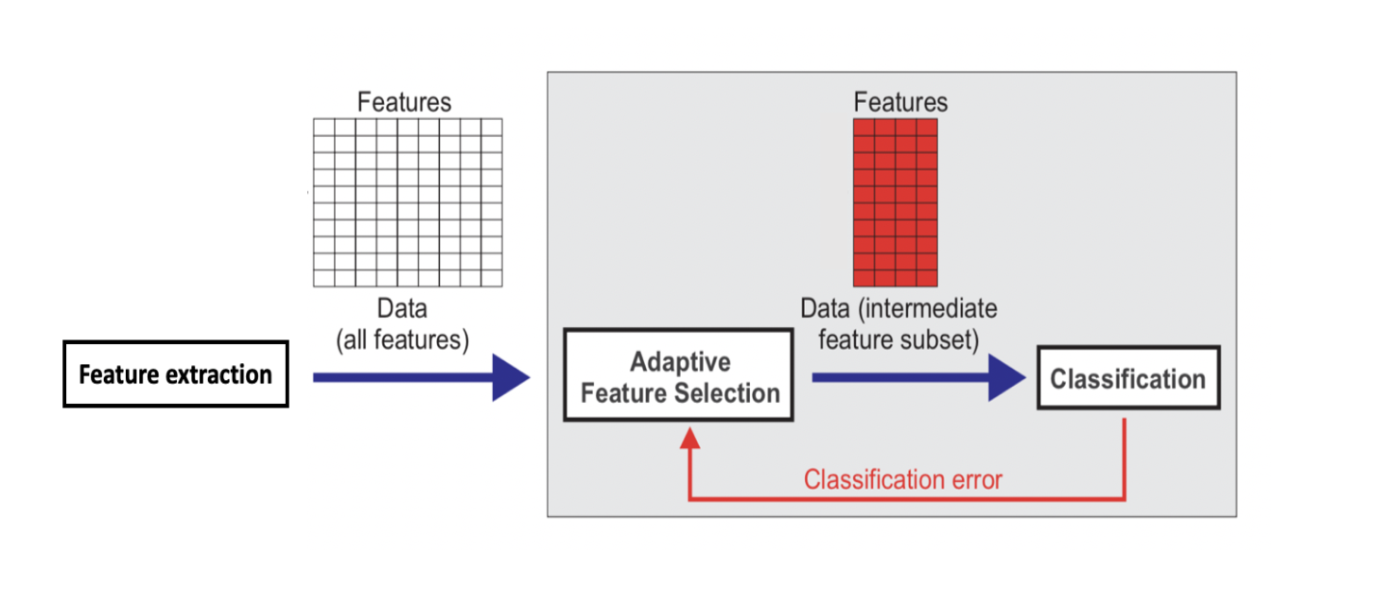
Feature selection – Wrapper Method
In wrapper method, the process of feature selection takes place in an iterative aspect by tuning the feature subset to a classifier.
The chosen feature subset is entirely dependent on the evaluated classification error. The feature subset with a very small estimated classification error is preferred.
The wrapper approach is considered to be expensive as it depends on the classification error at every iteration.
The popular search strategies that follows wrapper approach are sequential forward selection (SFS), sequential backward elimination (SBE), sequential floating forward selection (SFFS), Genetic algorithms, etc.

Slide 25
Feature selection – Embedded Method
An embedded method is a combination of filter method and wrapper method.
It takes advantages of both the methods to avoid the manual specification of threshold score and at the same time, learns which feature subset contribute to the best accuracy of the classifier model.
The common embedded feature selection methods are regularization methods which introduces constraints into the optimization of a predictive algorithm.
Examples of embedded feature selection methods are LASSO (least absolute shrinkage and selection operator), elastic net, etc.
The computational complexity of this approach tends to be between filter and wrapper methods.

Slide 26
Thank You!

